Slide 1
CS162 Operating Systems and Systems Programming Lecture 2 Introduction to Processes
January 22nd, 2018
Profs. Anthony D. Joseph and Jonathan Ragan-Kelley
http://cs162.eecs.Berkeley.edu

Slide 2
Recall: What is an operating system?
Special layer of software that provides application software access to hardware resources
Convenient abstraction of complex hardware devices
Protected access to shared resources
Security and authentication
Communication amongst logical entities
appln
appln
appln
OS
Hardware

Slide 3
Very Brief History of OS
Several Distinct Phases:
Notes:
Gone from people serving computers to computers serving people.
Except for the odd outlier like Pleo, that people need to take care of, virtually feed and play with.

Slide 4
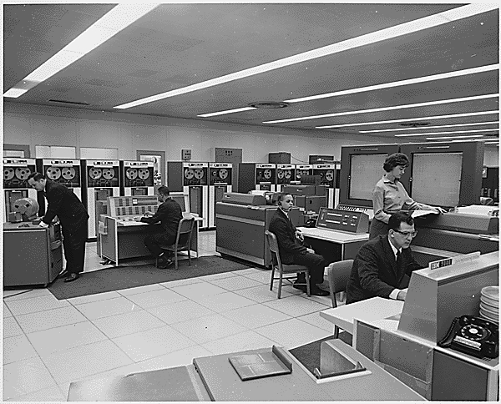
Very Brief History of OS
Several Distinct Phases:
Hardware Expensive, Humans Cheap
Eniac, … Multics
“I think there is a world market for maybe five computers.” – Thomas Watson, chairman of IBM, 1943
Notes:
Gone from people serving computers to computers serving people.
Except for the odd outlier like Pleo, that people need to take care of, virtually feed and play with.

Slide 5
Very Brief History of OS
Several Distinct Phases:
Hardware Expensive, Humans Cheap
Eniac, … Multics
Thomas Watson was often called “the worlds greatest salesman” by the time of his death in 1956
Notes:
Gone from people serving computers to computers serving people.
Except for the odd outlier like Pleo, that people need to take care of, virtually feed and play with.

Slide 6
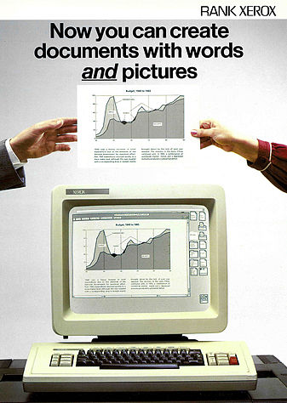
Very Brief History of OS
Several Distinct Phases:
Hardware Expensive, Humans Cheap
Eniac, … Multics
Hardware Cheaper, Humans Expensive
PCs, Workstations, Rise of GUIs
Notes:
Gone from people serving computers to computers serving people.
Except for the odd outlier like Pleo, that people need to take care of, virtually feed and play with.

Slide 7
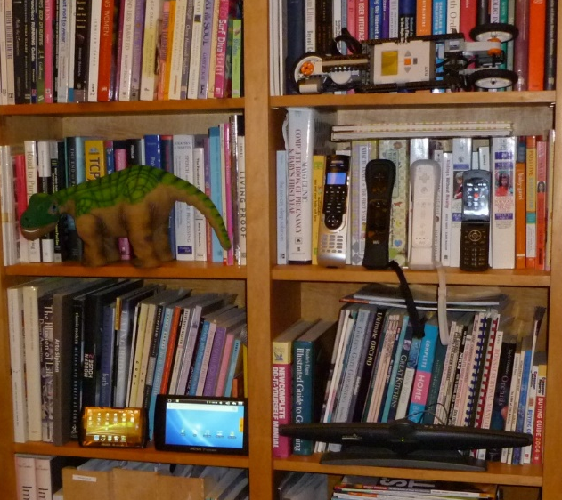
Very Brief History of OS
Several Distinct Phases:
Hardware Expensive, Humans Cheap
Eniac, … Multics
Hardware Cheaper, Humans Expensive
PCs, Workstations, Rise of GUIs
Hardware Really Cheap, Humans Really Expensive
Ubiquitous devices, Widespread networking
Notes:
Gone from people serving computers to computers serving people.
Except for the odd outlier like Pleo, that people need to take care of, virtually feed and play with.

Slide 8
Very Brief History of OS
Several Distinct Phases:
Hardware Expensive, Humans Cheap
Eniac, … Multics
Hardware Cheaper, Humans Expensive
PCs, Workstations, Rise of GUIs
Hardware Really Cheap, Humans Really Expensive
Ubiquitous devices, Widespread networking
Rapid change in hardware leads to changing OS
Batch ⇒ Multiprogramming ⇒ Timesharing ⇒ Graphical UI ⇒ Ubiquitous Devices
Gradual migration of features into smaller machines
Today
Small OS: 100K lines / Large: 10M lines (5M browser!)
100-1000 people-years

Slide 9
OS Archaeology
Because of the cost of developing an OS from scratch, most modern OSes have a long lineage:
Multics → AT&T Unix → BSD Unix → Ultrix, SunOS, NetBSD,…
Mach (micro-kernel) + BSD → NextStep → XNU → Apple OS X, iPhone iOS, Watch OS
MINIX → Linux → Android OS, Chrome OS, RedHat, Ubuntu, Fedora, Debian, Suse,…
CP/M → QDOS → MS-DOS → Windows 3.1 → NT → 95 → 98 → 2000 → XP → Vista → 7 → 8 → 10 → Xbox One → …
Notes:
Multics: MIT, GE, Bell Labs, 1969
Revolutionary but “bloated” at 135kB
Famous “failures”: Multics, Mach, NextStep: innovative but too flawed to succeed.
Microsoft established itself by writing an OS to compete with CP/M which IBM couldn’t negotiate with its author. They instead bought QDOS from a small code author who had written it from the CP/M manual.
Interestingly, there were some other OSes that didn’t have such a long lineage (e.g. IBM OS/2)

Slide 10
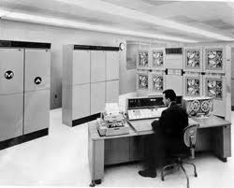
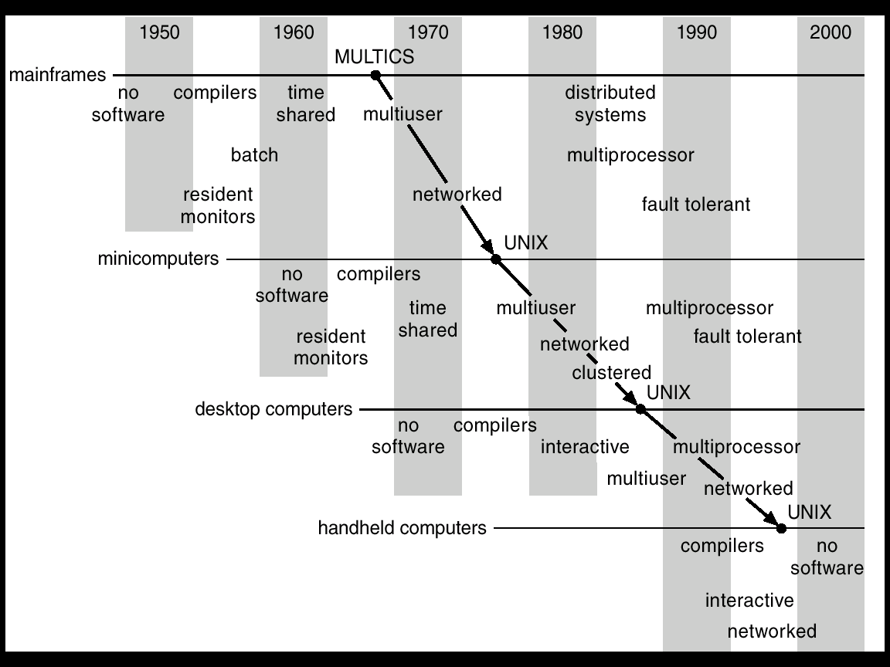
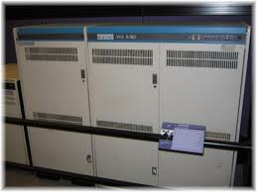
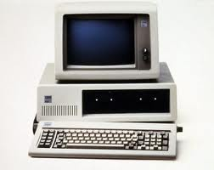
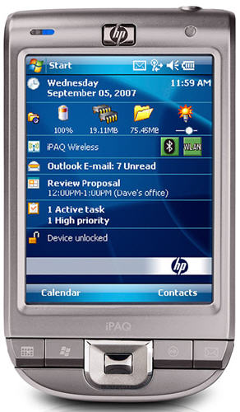
Migration of OS Concepts and Features

Slide 11
Today: Four Fundamental OS Concepts
Thread
Single unique execution context: fully describes program state
Program Counter, Registers, Execution Flags, Stack
Address space (with translation)
Programs execute in an address space that is distinct from the memory space of the physical machine
Process
An instance of an executing program is a process consisting of an address space and one or more threads of control
Dual mode operation / Protection
Only the “system” has the ability to access certain resources
The OS and the hardware are protected from user programs and user programs are isolated from one another by controlling the translation from program virtual addresses to machine physical addresses

Slide 12

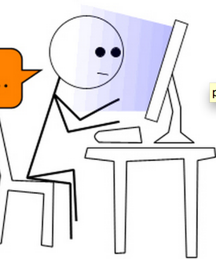
OS Bottom Line: Run Programs
0xFFF…
Executable
Program Source
OS
int main()
{ … ;
}
compiler
data
Load & Execute
stack
editor
Memory
instructions
heap
a.out
data
foo.c
Load instruction and data segments of executable file into memory
Create stack and heap
“Transfer control to program”
Provide services to program
While protecting OS and program
instructions
0x000…
PC:
registers
Processor

Slide 13
Recall (61C): Instruction Fetch/Decode/Execute
The instruction cycle
Memory
Processor
next
PC:
Instruction fetch
instruction
Decode
decode
Registers
Execute
ALU
data

Slide 14
Recall (61C): What happens during program execution?
Addr 2³²-1
R0
…
R31
F0
…
F30
PC
…
Data1
Data0
Inst237
Inst236
…
Inst5
Inst4
Inst3
Inst2 Inst1
Inst0
Fetch
Exec
Execution sequence:
Fetch Instruction at PC
Decode
Execute (possibly using registers)
Write results to registers/mem
PC = Next Instruction(PC)
Repeat
PC
PC
PC
PC
Addr 0

Slide 15
First OS Concept: Thread of Control
Certain registers hold the context of thread
Stack pointer holds the address of the top of stack
Other conventions: Frame pointer, Heap pointer, Data
May be defined by the instruction set architecture or by compiler conventions
Thread: Single unique execution context
Program Counter, Registers, Execution Flags, Stack
A thread is executing on a processor when it is resident in the processor registers.
PC register holds the address of executing instruction in the thread
Registers hold the root state of the thread.
The rest is “in memory”

Slide 16
Second OS Concept: Program’s Address Space
Address space ⇒ the set of accessible addresses + state associated with them:
For a 32-bit processor there are 2³² = 4 billion addresses
What happens when you read or write to an address?
Perhaps nothing
Perhaps acts like regular memory
Perhaps ignores writes
Perhaps causes I/O operation
(Memory-mapped I/O)
Perhaps causes exception (fault)
0xFFF…
stack
heap
Static Data
code
0x000…

Slide 17
Address Space: In a Picture
0xFFF…
stack
PC:
SP:
heap
Processor
registers
Static Data
instruction
Code Segment
0x000…
What’s in the code segment? Static data segment?
What’s in the Stack Segment?
How is it allocated? How big is it?
What’s in the Heap Segment?
How is it allocated? How big?

Slide 18
Multiprogramming - Multiple Threads of Control
Proc 1
Proc 2
Proc n
stack
…
heap
Static Data
OS
code
stack
heap
Static Data
code
stack
heap
Static Data
code

Slide 19
Administrivia: Getting started
Start homework 0 immediately ⇒ Due next Monday (1/29)!
cs162-xx account, Github account, registration survey
Vagrant and VirtualBox – VM environment for the course
Consistent, managed environment on your machine
Get familiar with all the cs162 tools, submit to autograder via git
Homework slip days: You have 3 slip days
THIS Friday (1/26) is early drop day! Very hard to drop afterwards…
Should be going to section already!
Group sign up form will be out after drop deadline
Work on finding groups ASAP: 4 people in a group!
Try to attend either same section or 2 sections by same TA

Slide 20
How can we give the illusion of multiple processors?
vCPU1
vCPU2
vCPU3
vCPU1
vCPU2
vCPU3
vCPU1
vCPU2
Shared Memory
Time
Assume a single processor. How do we provide the illusion of multiple processors?
Multiplex in time!
Each virtual “CPU” needs a structure to hold:
Program Counter (PC), Stack Pointer (SP)
Registers (Integer, Floating point, others…?)
How switch from one virtual CPU to the next?
Save PC, SP, and registers in current state block
Load PC, SP, and registers from new state block
What triggers switch?
Timer, voluntary yield, I/O, other things

Slide 21
The Basic Problem of Concurrency
The basic problem of concurrency involves resources:
Hardware: single CPU, single DRAM, single I/O devices
Multiprogramming API: processes think they have exclusive access to shared resources
OS has to coordinate all activity
Multiple processes, I/O interrupts, …
How can it keep all these things straight?
Basic Idea: Use Virtual Machine abstraction
Simple machine abstraction for processes
Multiplex these abstract machines
Dijkstra did this for the “THE system”
Few thousand lines vs 1 million lines in OS 360 (1K bugs)

Slide 22
Properties of this simple multiprogramming technique
All virtual CPUs share same non-CPU resources
I/O devices the same
Memory the same
Consequence of sharing:
Each thread can access the data of every other thread (good for sharing, bad for protection)
Threads can share instructions (good for sharing, bad for protection)
Can threads overwrite OS functions?
This (unprotected) model is common in:
Embedded applications
Windows 3.1/Early Macintosh (switch only with yield)
Windows 95—ME (switch with both yield and timer)

Slide 23
Protection
Operating System must protect itself from user programs
Reliability: compromising the operating system generally causes it to crash
Security: limit the scope of what processes can do
Privacy: limit each process to the data it is permitted to access
Fairness: each should be limited to its appropriate share of system resources (CPU time, memory, I/O, etc)
It must protect User programs from one another
Primary Mechanism: limit the translation from program address space to physical memory space
Can only touch what is mapped into process address space
Additional Mechanisms:
Privileged instructions, in/out instructions, special registers
syscall processing, subsystem implementation
(e.g., file access rights, etc)

Slide 24
Third OS Concept: Process
Process: execution environment with Restricted Rights
Address Space with One or More Threads
Owns memory (address space)
Owns file descriptors, file system context, …
Encapsulate one or more threads sharing process resources
Why processes?
Protected from each other!
OS Protected from them
Processes provides memory protection
Threads more efficient than processes (later)
Fundamental tradeoff between protection and efficiency
Communication easier within a process
Communication harder between processes
Application instance consists of one or more processes

Slide 25
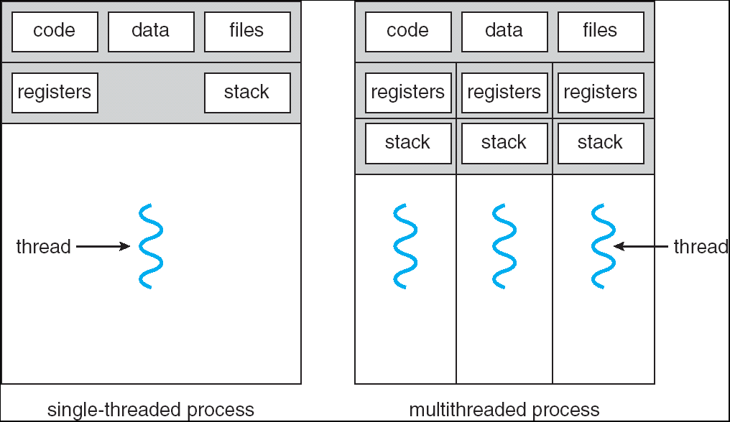
Single and Multithreaded Processes
Threads encapsulate concurrency: “Active” component
Address spaces encapsulate protection: “Passive” part
Keeps buggy program from trashing the system
Why have multiple threads per address space?
Notes:
Sometimes need parallelism for a single job, and processes are very expensive – to start, switch between, and to communicate between

Slide 26
Fourth OS Concept: Dual Mode Operation
Hardware provides at least two modes:
“Kernel” mode (or “supervisor” or “protected”)
“User” mode: Normal programs executed
What is needed in the hardware to support “dual mode” operation?
A bit of state (user/system mode bit)
Certain operations / actions only permitted in system/kernel mode
In user mode they fail or trap
User → Kernel transition sets system mode AND saves the user PC
Operating system code carefully puts aside user state then performs the necessary operations
Kernel → User transition clears system mode AND restores appropriate user PC
return-from-interrupt

Slide 27
User/Kernel (Privileged) Mode
User Mode
interrupt
exception
syscall
rtn
rfi
Kernel Mode
exit
exec
Limited HW access
Full HW access

Slide 28
Administrivia (Cont’d)
Anthony’s OH: Wednesdays 1-3PM 465F Soda starting 1/31
Jonathan’s OH : Mondays 1-2:45PM 525 Soda starting 1/29
Avoid private Piazza posts – others have same question
Three Free Online Textbooks:
Click on “Resources” link for a list of “Online Textbooks”
Can read O'Reilly books for free as long as on campus or VPN
One book on Git, two books on C
Webcast: https://CalCentral.Berkeley.edu/ (CalNet sign in)
Webcast is *NOT* a replacement for coming to class!

Slide 29
5 min break

Slide 30
Simple Protection: Base and Bound (B&B)
0000…
0000…
code
code
Static Data
Static Data
heap
heap
stack
0100…
stack
Base
0010…
1000…
1000…
code
>=
Program
address
1010…
Static Data
heap
Bound
<
1100…
stack
1100…
FFFF…

Slide 31
Simple Protection: Base and Bound (B&B)
0000…
0000…
code
code
Static Data
Static Data
heap
heap
stack
0100…
stack
Base
0010…
1000…
1000…
code
>=
Program
address
1010…
Static Data
heap
Addresses translated when program is loaded
Bound
<
1100…
stack
1100…
Requires relocating loader
Still protects OS and isolates program
No addition on address path
FFFF…

Slide 32
Another idea: Address Space Translation
Program operates in an address space that is distinct from the physical memory space of the machine
“physical address”
0x000…
“virtual address”
Processor
translator
Memory
0xFFF…

Slide 33
A simple address translation with Base and Bound
0000…
0000…
code
code
Static Data
Addresses translated on-the-fly
Static Data
heap
heap
stack
Base Address
stack
1000…
1000…
0010…
code
Program
address
0010…
Static Data
heap
Bound
<
stack
1100…
0100…
Can the program touch OS?
Can it touch other programs?
FFFF…

Slide 34
Tying it together: Simple B&B: OS loads process
0000…
Proc 1
Proc 2
Proc n
code
…
Static Data
OS
heap
stack
sysmode
1
1000…
code
Base
xxxx …
0000…
Static Data
Bound
xxxx…
FFFF…
heap
uPC
xxxx…
stack
1100…
PC
code
3000…
regs
Static Data
…
heap
stack
3080…
FFFF…

Slide 35
Simple B&B: OS gets ready to execute process
0000…
Proc 1
Proc 2
Proc n
code
RTU
…
Static Data
OS
heap
stack
sysmode
1
1000…
code
Base
1000 …
0000…
Static Data
Bound
1100…
FFFF…
heap
uPC
0001…
stack
1100…
PC
Privileged Inst: set special registers
RTU
code
3000…
regs
00FF…
Static Data
…
heap
stack
3080…
FFFF…

Slide 36
Simple B&B: User Code Running
0000…
Proc 1
Proc 2
Proc n
code
…
Static Data
OS
heap
stack
sysmode
0
1000…
code
Base
1000 …
0000…
Static Data
Bound
1100…
FFFF…
heap
uPC
xxxx…
How does kernel switch between processes?
First question: How to return to system?
stack
1100…
PC
0001…
code
3000…
regs
00FF…
Static Data
…
heap
stack
3080…
FFFF…

Slide 37
3 types of Mode Transfer
Syscall
Process requests a system service, e.g., exit
Like a function call, but “outside” the process
Does not have the address of the system function to call
Like a Remote Procedure Call (RPC) – for later
Marshall the syscall id and args in registers and exec syscall
Interrupt
External asynchronous event triggers context switch
e. g., Timer, I/O device
Independent of user process
Trap or Exception
Internal synchronous event in process triggers context switch
e.g., Protection violation (segmentation fault), Divide by zero, …
All 3 are an UNPROGRAMMED CONTROL TRANSFER
Where does it go?

Slide 38
How do we get the system target address of the “unprogrammed control transfer?”

Slide 39
Interrupt Vector
Address and properties of each interrupt handler
interrupt number (i)
intrpHandler_i () {
….
}
Where else do you see this dispatch pattern?

Slide 40
Simple B&B: User => Kernel
0000…
Proc 1
Proc 2
Proc n
code
…
Static Data
OS
heap
stack
sysmode
0
1000…
code
Base
1000 …
0000…
Static Data
Bound
1100…
FFFF…
heap
uPC
xxxx…
stack
1100…
PC
0000 1234
code
3000…
regs
00FF…
Static Data
How to return to system?
…
heap
stack
3080…
FFFF…

Slide 41
Simple B&B: Interrupt
0000…
Proc 1
Proc 2
Proc n
code
…
Static Data
OS
heap
stack
sysmode
1
1000…
code
Base
1000 …
0000…
Static Data
Bound
1100 …
FFFF…
heap
uPC
0000 1234
stack
1100…
PC
IntrpVector[i]
code
3000…
regs
00FF…
Static Data
How to save registers and set up system stack?
…
heap
stack
3080…
FFFF…

Slide 42
Simple B&B: Switch User Process
0000…
Proc 1
Proc 2
Proc n
code
RTU
…
Static Data
OS
heap
stack
sysmode
1
1000…
1000 …
code
Base
3000 …
0000…
Static Data
1100 …
Bound
0080 …
FFFF…
heap
0000 1234
uPC
0000 0248
regs
stack
1100…
PC
0001 0124
00FF…
code
3000…
regs
00D0…
Static Data
How to save registers and set up system stack?
…
heap
stack
3080…
FFFF…

Slide 43
Simple B&B: “resume”
0000…
Proc 1
Proc 2
Proc n
code
RTU
…
Static Data
OS
heap
stack
sysmode
0
1000…
1000 …
code
Base
3000 …
0000…
Static Data
1100 …
Bound
0080 …
FFFF…
heap
0000 1234
uPC
xxxx xxxx
regs
stack
1100…
PC
000 0248
00FF…
code
3000…
regs
00D0…
Static Data
How to save registers and set up system stack?
…
heap
stack
3080…
FFFF…

Slide 44
Conclusion: Four fundamental OS concepts
Thread
Single unique execution context
Program Counter, Registers, Execution Flags, Stack
Address Space with Translation
Programs execute in an address space that is distinct from the memory space of the physical machine
Process
An instance of an executing program is a process consisting of an address space and one or more threads of control
Dual Mode operation/Protection
Only the “system” has the ability to access certain resources
The OS and the hardware are protected from user programs and user programs are isolated from one another by controlling the translation from program virtual addresses to machine physical addresses

